Slide 1
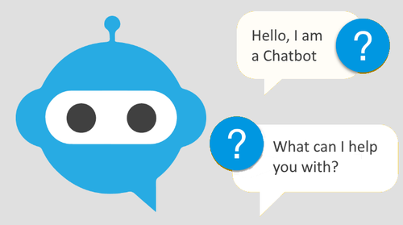
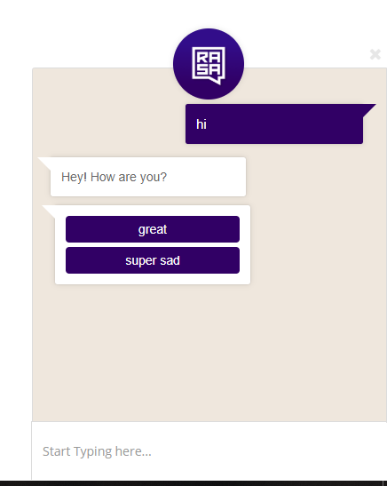
ChatBot
Wednesday, 14 December 2022

Slide 2
“An investment in knowledge pays the best interest“
- Benjamin Franklin

Slide 3
Agenda
What is a chatbot?
Types of the chatbot
History of the chatbot
How chatbots works
Why chatbot?
Applications of the chatbot
Chatbot framework

Slide 4
What is a Chatbot ?
A chatbot is a software application used to conduct an on-line chat conversation via text or via voice.
A chatbot is a computer software replicate human conversations.

Slide 5
Types of Chatbot
Rule-based bots : With this type of bot, communication is through pre-set rules. User input must confirm to these pre-defined rules in order to get an answer. Often with such bots only buttons are used. Since no artificial intelligence is used here, an open conversation with this type of bot is not possible or very limited.
NLP & NLU based: It’s a AI based approach Natural language understanding (NLU) refers to a chatbot's capacity to comprehend human speech. It is the process of transforming unstructured text into structured data that can be understood by a machine. Natural Language Processing (NLP) are meant to turn a user's text or speech into structured data

Slide 6
Where you can find chatbots?
Website Chatbot: It may be opened in your browser. They can sometimes appear as a little widget. They can also be used as a distinct landing page.
Messenger Chatbot: On social media and instant messaging services, chatbots are extremely popular. A Facebook chatbot, on the other hand, can be a fantastic complement to a business page.
Voice based Chatbot: Millions of people use Alexa or Siri from Amazon without considering them to be chatbots. They're artificial intelligence-enabled voice chatbots.

Slide 7
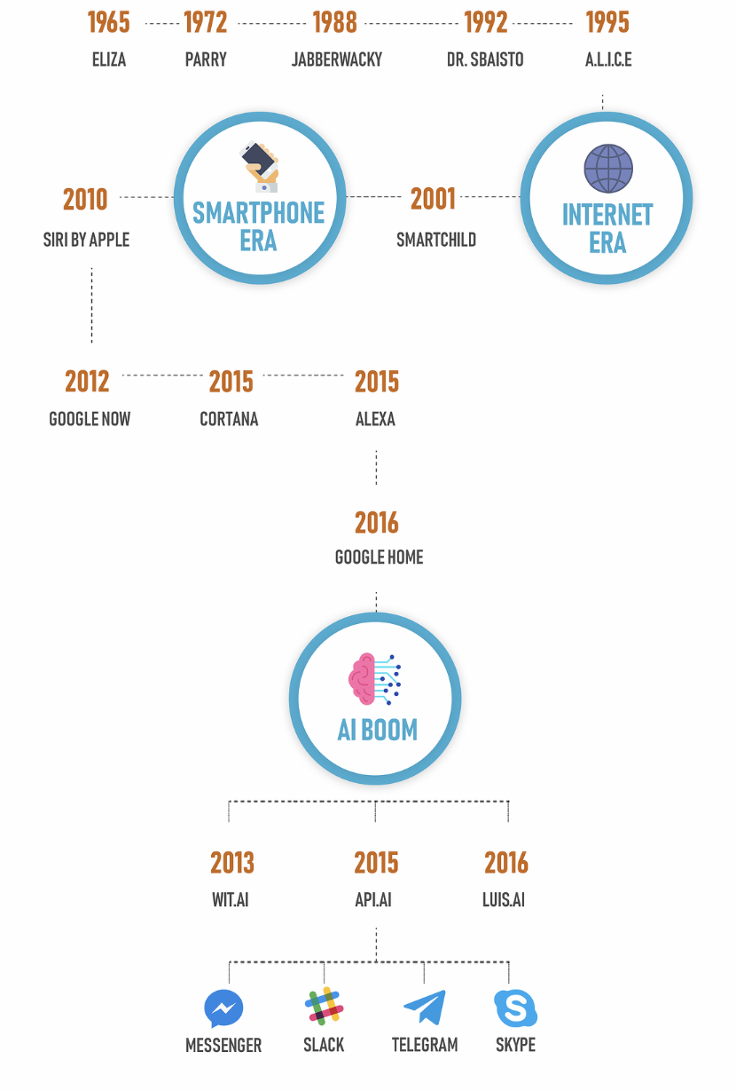
What is the chatbot's legacy?

Slide 8
Why Chatbot ?
24*7 Availability
Consistency in answers
Instant response
Enhance customer engagement
Lower cost
Save time
Multilingual

Slide 9
Applications of Chatbot
Messaging apps : Facebook Messenger allowed developers to place chatbots on their platform. As part of company apps and websites Customer Service Company internal platforms
Healthcare : Chatbots are also appearing in the healthcare industry. A study suggested that physicians in the United States believed that chatbots would be most beneficial for scheduling doctor appointments, locating health clinics, or providing medication information.
Politics : In India, the state government has launched a chatbot for its Appeal Sarkar platform, which provides conversational access to information regarding public services managed.
Toy : Hello Barbie is an Internet-connected version of the doll that uses a chatbot provided by the company Toy Talk
-

Slide 10
Chatbot Framework
Microsoft Bot Framework
Dialog flow
Amazon lex
IBM Watson
RASA Stack
Chatterbot
Wit.ai

Slide 11
Thank you

